Slide 1
Solution for hotels and landlords of rental accommodation

Slide 2
Table of contents
Briefly about us
Solution for hotels and landlords
Adderra basic configuration
Payments via ADDERRA smartphone application
Payments via KEY FOB
Key stakeholders
How it works
Commercial value
ADD Grup & Adderra
Our Products
Case of hotel “Amor de Helene”
Contacts

Slide 3
Adderra is an individual sub-metering system for measurement of electricity and water with integrated billing and payment platform.
Adderra
is…
The solution involves the use of certified hardware (electricity and water meters) and an online marketplace with smartphone application.
The marketplace enables sales of tokens for electricity and water in pre-and post-payment or in preset credit limits mode.
See the solution
3

Slide 4
Solution for hotels and short-term accommodation
So, your tenants will be able to consume only the utilities they have paid for through application.
Adderra allows to separate the price for utilities from accommodation fee.
Thus, our service motivates hotel guests and tenants to rationalize their consumption behavior.
See the solution
4

Slide 5
Solution for long-term landlords
Adderra gives you the opportunity to avoid unpaid bills left by tenants.
If a tenant does not pay for water and electricity, Adderra will cut off the supply.
Therefore, landlords have three options to make tenants pay for the resources: prepayment/postpayment mode or on a preset credit limits mode.
See Adderra configuration
5

Slide 6
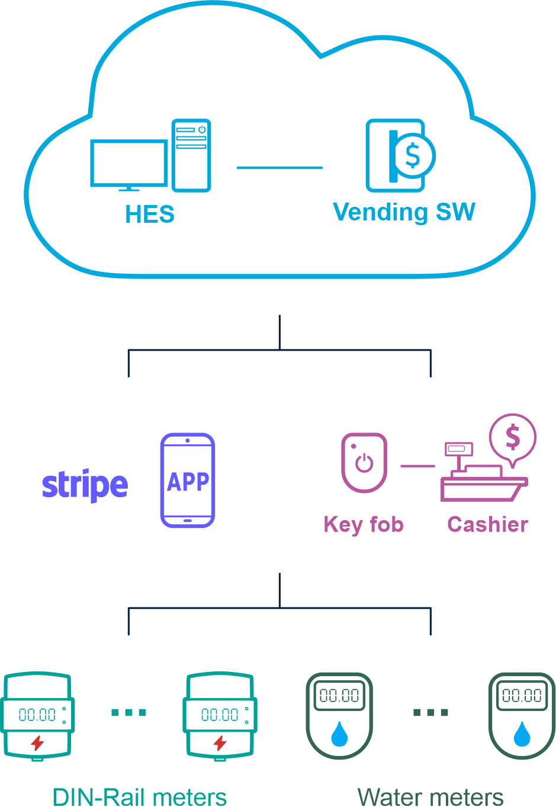
ADDERRA Basic configuration
Cloud-based ADDERRA backend
Vending software developed and hosted by ADD GRUP.
2 types of payment for electricity and water :
ADDERRA smartphone application
Smart key fob
Electricity Meter and Ultrasonic Water meter with BLE communication channel
See application payments
6

Slide 7
1. Payments via ADDERRA smartphone application
Postpayment | Tenants pay for the utilities after receiving Adderra’s billing at the end of billing period. A tenant connects to the meters via Adderra application and clicks the start service button. The meters activate and start counting the amount of water and electricity a tenant is using. At the end of billing period (which is established on the basis of an agreement between landlords and tenants) the tenant pays the corresponding amount of money throughout application by credit card. This money is transferred to PayPal/Stripe account of a landlord, after which the landlord transfers the payment to utility supply company.
Prepayment | Tenants pay for the utilities before consumption. In this case, tenants after connecting to the meter pay the amount they are going to consume and only then start using water and electricity. As soon as their credit is over, tenants will receive a notification to top up the credit.
Preset credit limit | Tenants pay for the utilities as they reach the pre-established limits expressed in monetary value or cubic meters and kilowatts. For example, landlord can set a limit for 2 m3 of water and 100 Kwh of electricity. As tenant reaches these limits, they have to pay corresponding amount and then they can continue consuming the utilities.
*Landlords can switch the way a tenant pays for the utilities changing easily configuration in their app’s profiles
See key fob payments
7

Slide 8
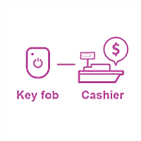
2. Payments via KEY FOB
Key fob payment mode is an option for those tenants who wish to pay for the water and electricity by cash. In a such way, tenants pay landlord the certain amount of money they are going to use in cash and landlords, in their turn, generate tokens via application and transform these tokens to the key fob through Bluetooth. Then, tenants activate the meter, sending the token from the key fob through Bluetooth connection as well.
Key fob payment mode also supports prepayment, postpayment and present credit limit.
See stakeholders
8

Slide 9
1. Adderra
Marketplace developer
2. Marketplace operator
Adderra’s licensee
3. Hotel owners and Landlords
4. Guests and Tenants
5. Payment platform
Stripe
Key
stakeholders
See how it works
9

Slide 10
How it works
Stages 1-2
Stage 1. Hotel/Landlord on-boarding
1
2
3
2
3
Marketplace operator installs electricity and water meters in accommodation
Landlord /Hotel registers in Adderra marketplace with PayPal/Stripe account
Individual set-up of prices for electricity and water if necessary
Stage 2. Guest/Tenant check-in and payments
Guest/Tenant checks-in by scanning QR code of a meter via Adderra smartphone application and starts using electricity and water.
By agreement with hotel/landlord payments can be made either in pre-/ post-payment or in preset credit limits mode. Transactions are processed by PayPal or Stripe in a secure manner.
See how it works
10

Slide 11
How it works
Stages 3-4
Stage 3. Guest/Tenant check-out
3
3
As the rental period is over, Guest/Tenant will check-out and will request refunding for the unused amount of money, if there is such.
If the amount of money is blocked on the credit card, the Payment System will unblock it automatically.
If the transaction has been completed and money distributed earlier, the landlord/hotel will process the refund manually through ADDERRA application.
Stage 4. Cash flow
ADDERRA marketplace distributes money from transactions to Landlord’s/Hotel’s Stripe account excluding fees charged by Stripe and Marketplace.
See the benefits
11

Slide 12
Commercial Value
For marketplace operator | For Hotels and short-term accommodation | For long-term accommodation | For Guests and Tenants
Profit generated through: - sales of electricity and water meters to landlords - provision of installation services and after sales support - commissions from transactions between tenants and landlords for sales/purchase of tokens for electricity and water | Reduction of rental fees through removal of overestimated costs for electricity and water Avoidance of overconsumption and unnecessary spendings Increased sustainability in hotel industry | Rational management of utilities consumption No need to change the contracts with utility company from landlord to tenant | Only consumed resources are paid Fair price without overestimations Transparent and safe payments
See about ADD Grup
12

Slide 13
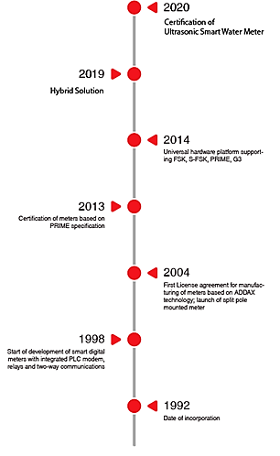
Adderra is the project of
Certification of Ultrasonic Smart Water Meter
About ADD Grup
High-tech company with more than 29 years of global success
Hybrid Solution
Projects in more than 30 countries worldwide
Universal hardware platform supporting FSK, S-FSK, PRIME, G3
Manufacturing facilities with up-to-date equipment from the best manufactures in the world
Certification of meters based on PRIME specification
First License agreement for manufacturing of meters based on ADDAX technology launch of split pole mounted meter
Start of development of smart digital meters with integrated PLC modem, relays and two-way communication
Date of incorporation
See our products
13

Slide 14
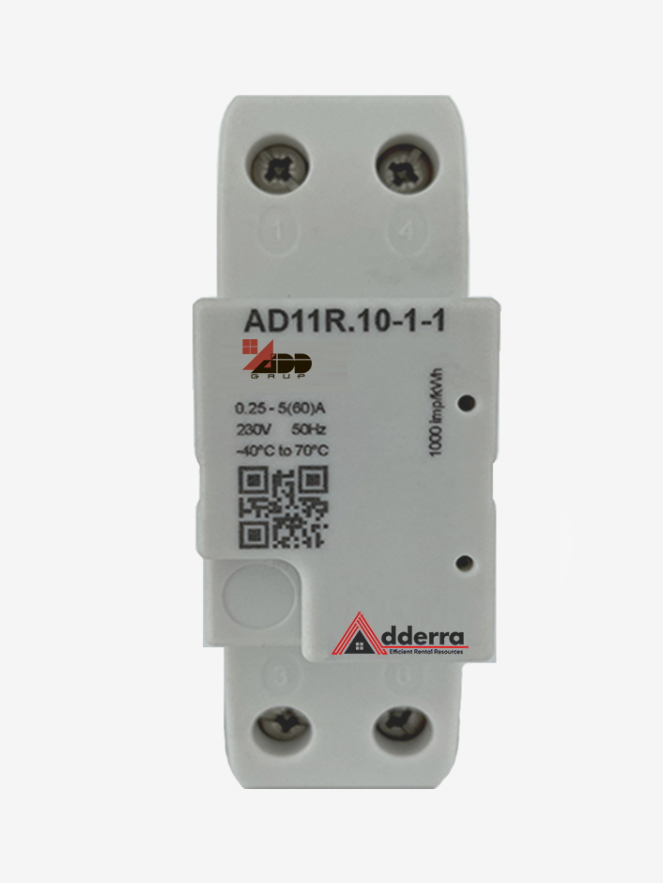
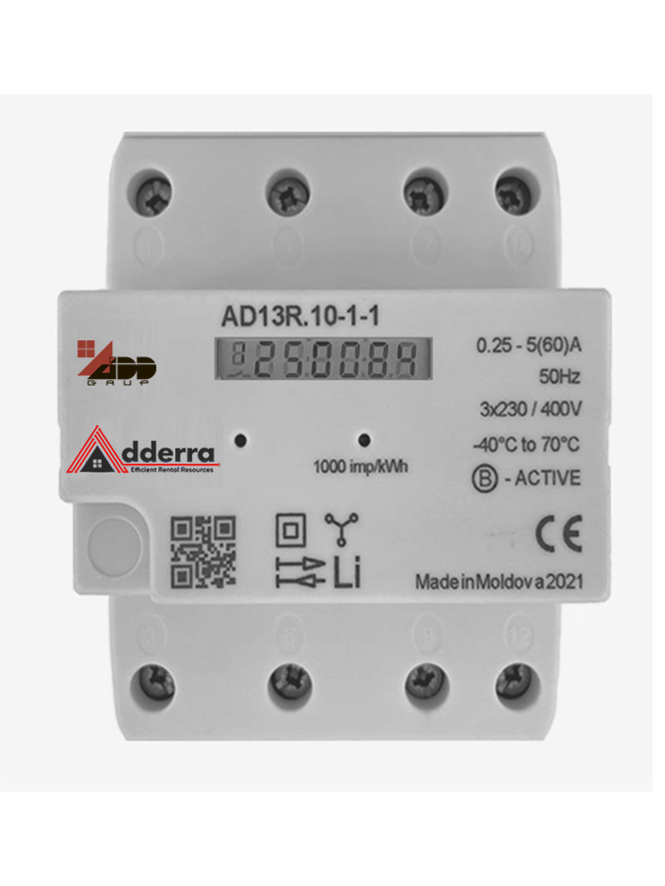
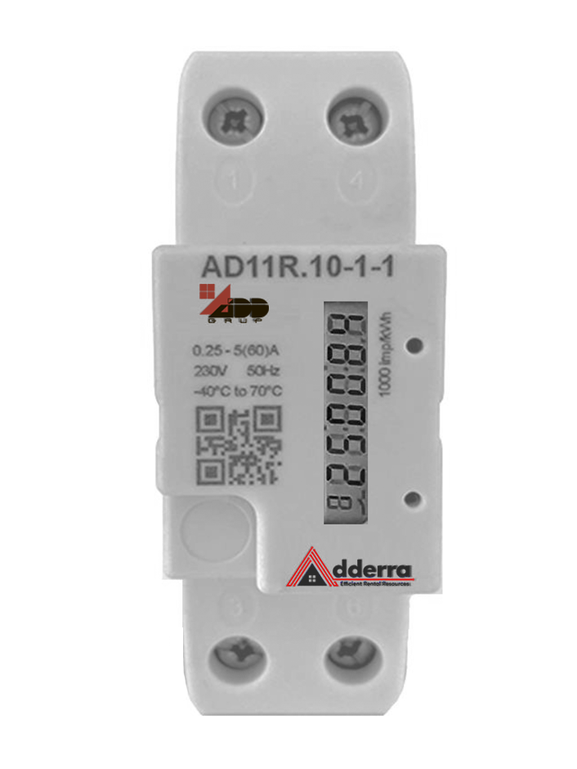
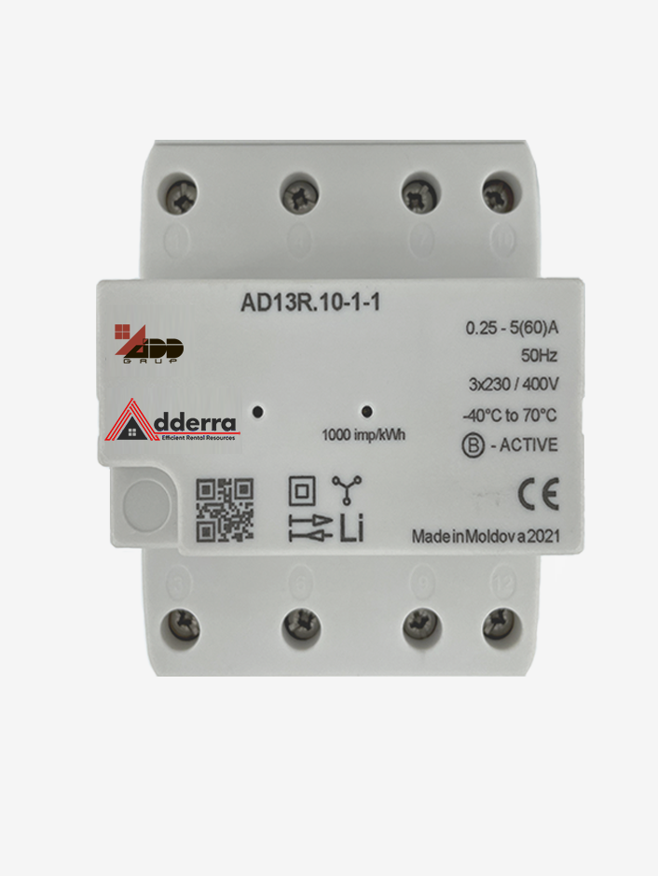
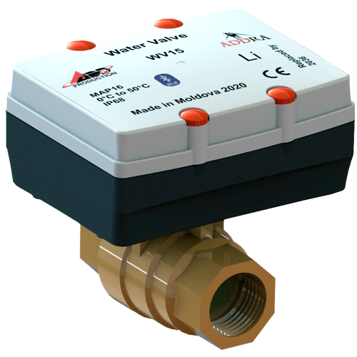
Our Products
ELECTRICITY METERING
Smart prepaid meters with disconnection relay
Communication through Bluetooth (BLE 5.0)
Prepayment and post-payment mode supported
The current balance in the local currency and in watt-hours and cubic meters
Consumers’ load disconnecting on credit amount exhaustion
User notification when:
No data exchange with the meter for a long time
The meter credit is exhausted
The payment time is close to expiring
The order time is close to expiring
single phase
three phase
WATER METERING
Ultrasonic smart prepaid water meter with shut-off valve
Water meter
shut-off valve
See Amor de Helene case
14

Slide 15
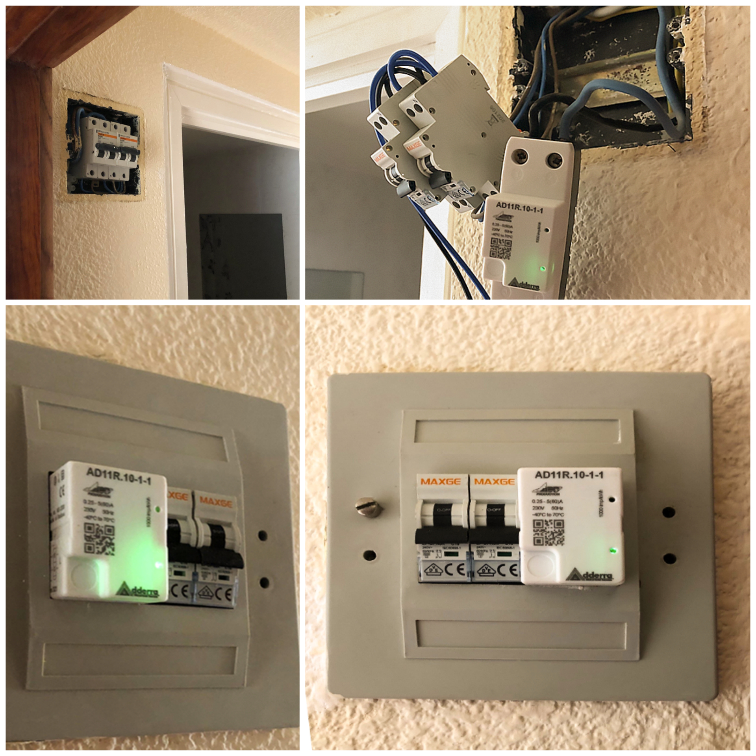
Case of Spanish hotel “Amor de Helene”
In July 2021 Adderra together with Arcostec, Adderra’s official representative in Spain, installed one phase and three phase electricity submeters. 14 of them were installed in the rooms and 1 submeter in the restaurant.
ADDERRA meters have a very compact design. Installation was performed inside the boxes with circuit-breakers at the entrance to each hotel room.
Contact us
15

Slide 16
Contact us
+373 (22) 93 00 12
www.adderra.com
info@adderra.com
Our offices
Republic of Moldova, 36 Dragomirna street, Chisinau, MD-2008
Wish you all the best!

