Slide 1
INDIAN SMART METERING ROADMAP
ADD GRUP Solution based
on ADDAX technology

Slide 2
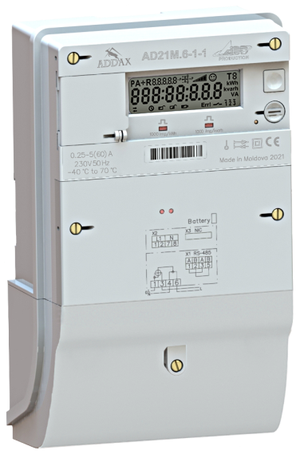
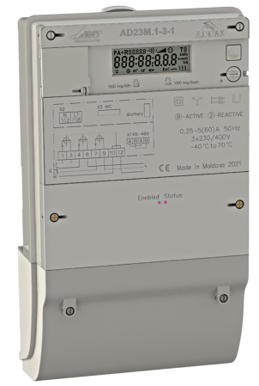
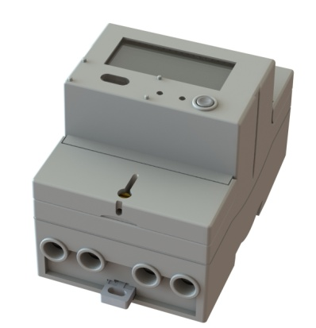
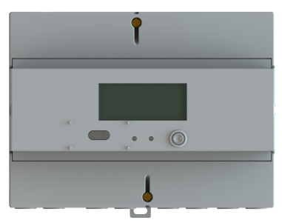
Smart metering characteristics
1
1
Communications:
Modular meter and DIN meters - via BLE channel;
WAN communications between Modular meter and HES :
Through the Data Concentrator over PLC, RF, Hybrid PLC+RF
or
Directly via 3GPP
HAN communication via BLE includes:
IO switch, relay status, on/off commands;
Control home appliances,
Support of other smart devices (gas, water utility meters);
Local interface for service functions
Smart meters with WAN and HAN abilities :
Modular meter with PLC, RF or Hybrid PLC+RF communication module, based on open standard G3-PLC.
Customers’ BLE-based DIN meters both 1-phase and
3-phase direct connected

Slide 3
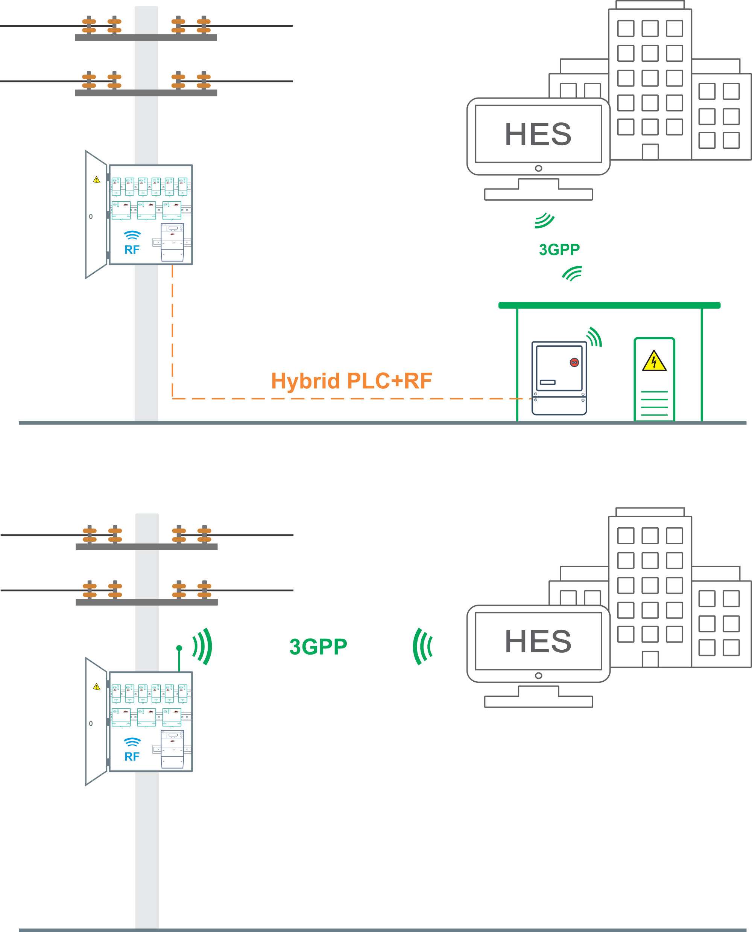
Group Metering Architecture
1
Modular Meter and consumer meters are placed on a pole within the protective box.
Single module for WAN communication for all meters in the box

Slide 4
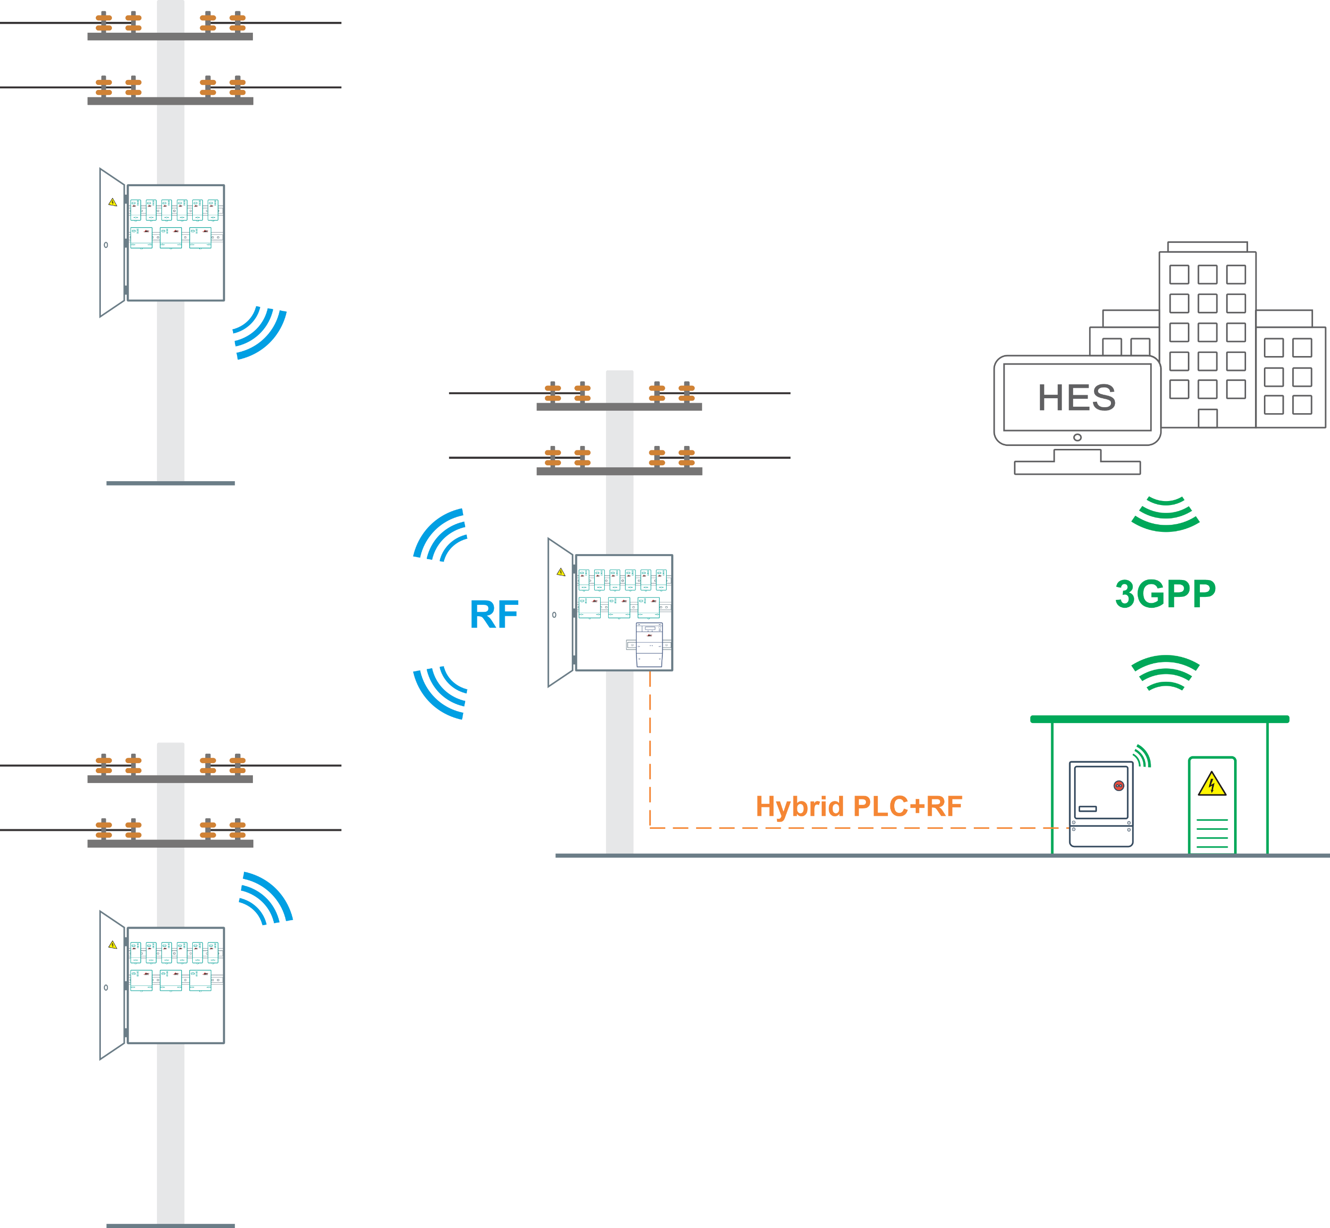
Group Metering in case
of closely-spaced poles
1
WAN communication via Hybrid PLC+RF
Single module for WAN communication for all meters in closely spaced boxes

Slide 5
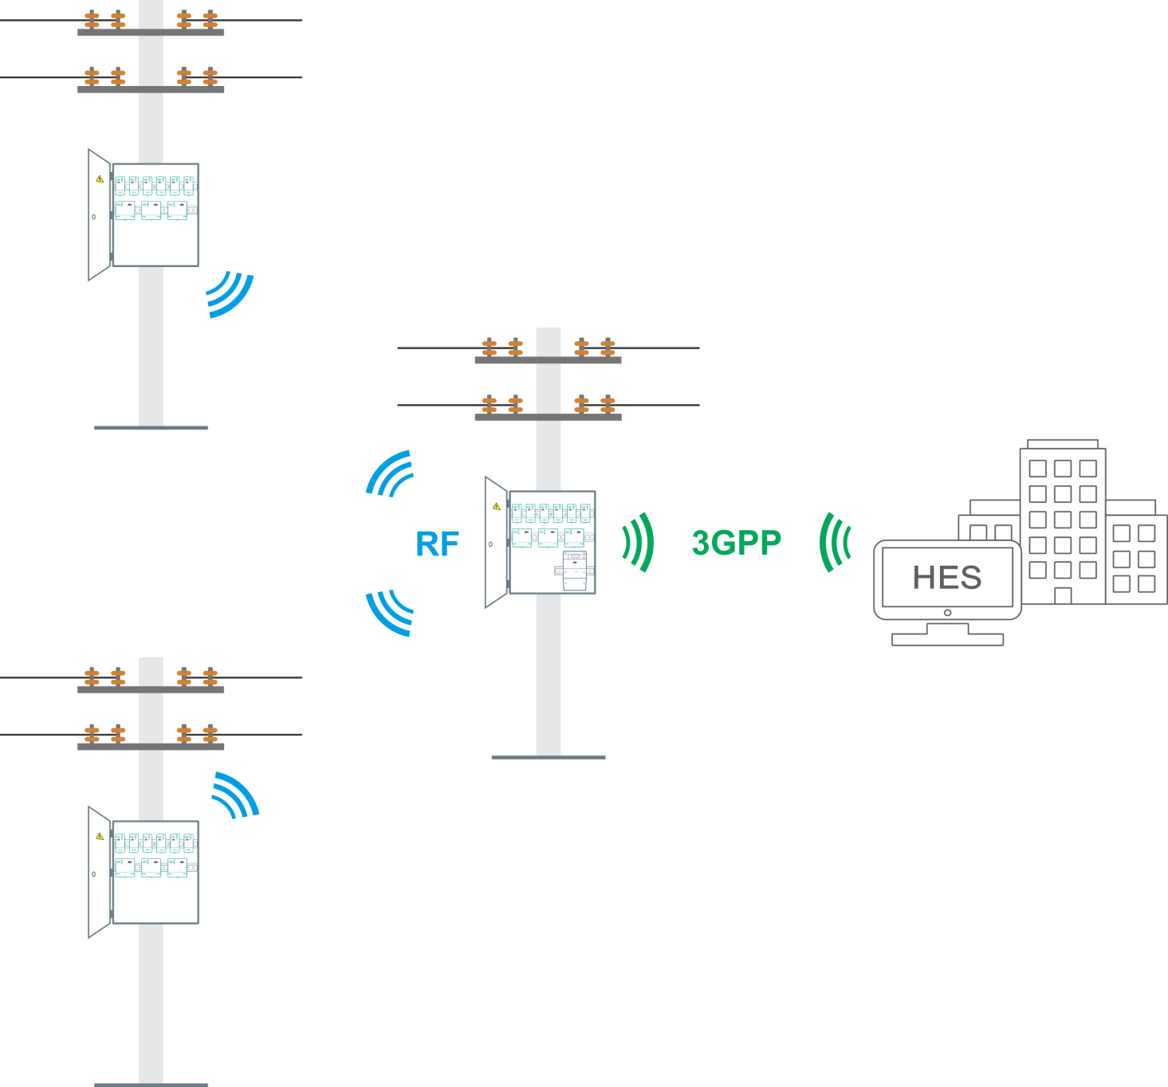
Group Metering in case
of closely-spaced poles
1
WAN communication via 3GPP
Single module for WAN communication for all meters in closely spaced boxes

Slide 6
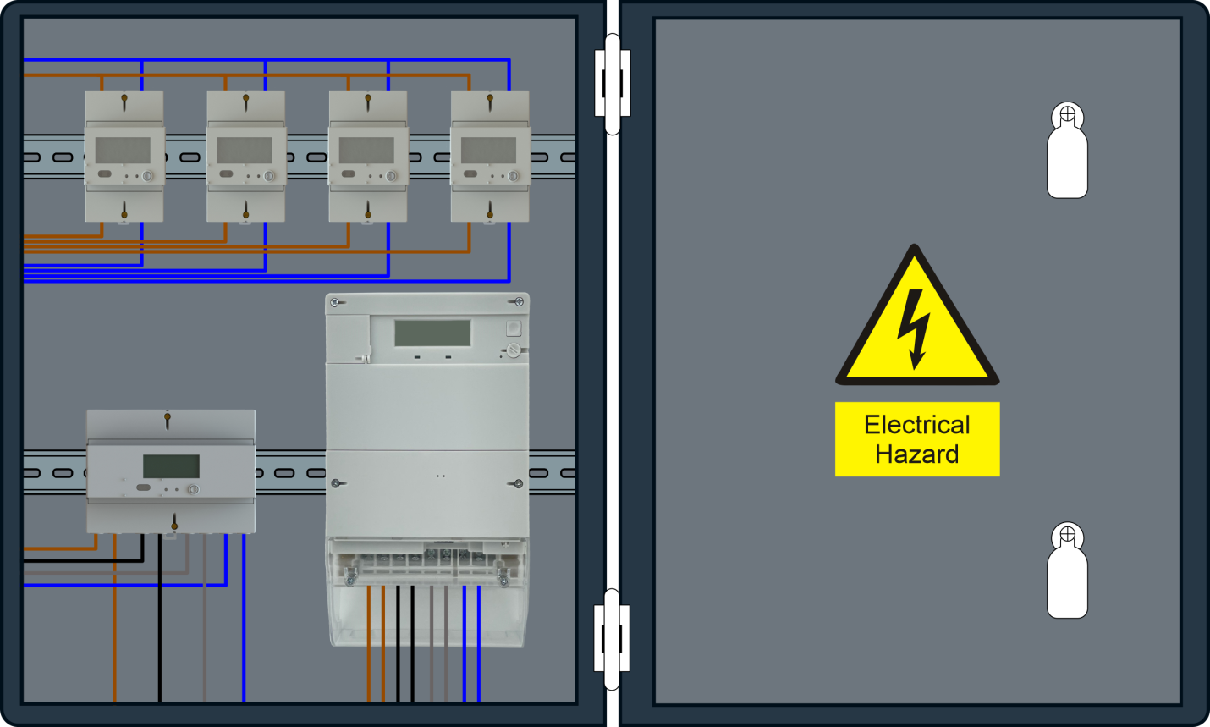
Group of smart meters placement details
1
All meters within the box are placed on DIN-rail.
The meters can be equipped with disconnecting relay.
1-phase and 3 phase customers’ meters can be arranged in any combination.
Only one modular meter is placed in each box.
Only modular meter has communication module for data exchange with the HES.
All meters communicate with each other via BLE interface

Slide 7
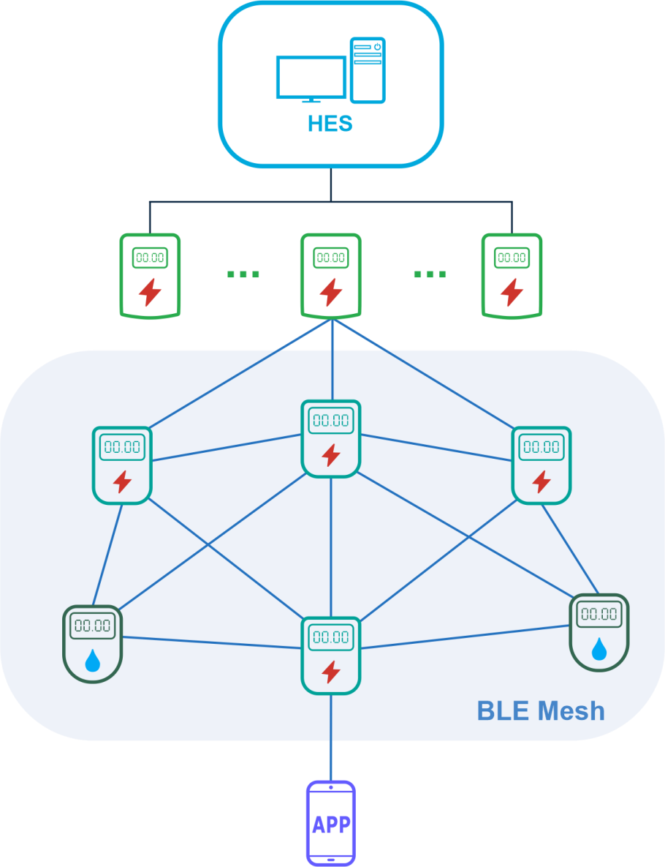
Future Integration of Utility devices
1
ADD GRUP or 3rd party HES.
Electricity Modular Meters with BLE and 3GPP communication channels.
BLE Mesh network structure substantially reduces the number of Modular meters
Customers can be connected/disconnected from power network by a command from HES transmitted via Modular Meters.
Other utilities meters (water, gas) can be integrated in the network by BLE communication channel.
Special mobile application is used for customer’s informing or service purposes.

Slide 8
Problems and Solutions
1
Network losses
Equipment illegal access
Power theft
Overdue payments
Low metering efficiency
Poor grid infrastructure and communications
Up-to-date communication technologies allows effective monitoring of the customer’s consumption and alarms
Tamper proof and prepayment options serve as an efficient solution to prevent energy theft
Flexible and scalable network architecture is based on distributed, modular, hierarchical and client-server concepts.

Slide 9
Benefits
1
Considerable reduction of the project cost
Substantial saving of devices purchase prices
Substantial saving of maintenance costs
Reduction of expenditures for Communication
Tamper and losses elimination

Slide 10
Solution developed
by ADD GRUP
BEYOND YOUR EXPECTATIONS

