Slide 1
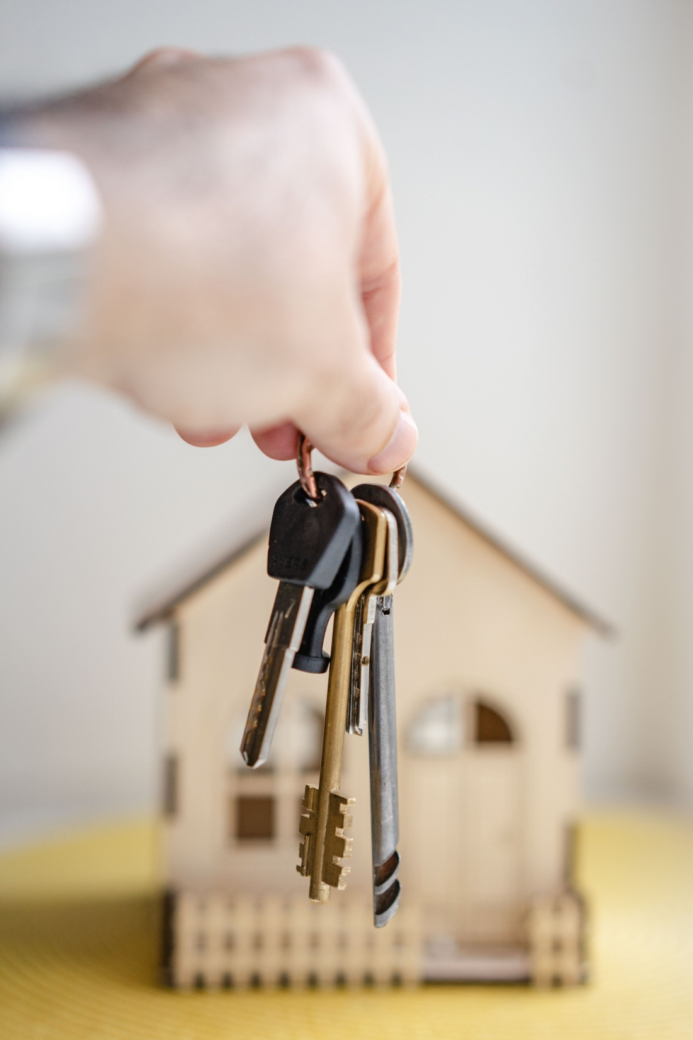
ADDERRA Utility Payment Control

Slide 2
ADDERRA utility (electricity and water) payment control solution is designed for use by the following stakeholders:
Hotels, apartments and guest houses for short-term and long-term rental
Commercial rental property (malls, offices etc)
Electricity and water companies supplying electricity and water for their consumers
ADDERRA Utility Payment Control Solution
ADDERRA backend is distributed as SaaS and hosted in the cloud.
Solution comprises the following capabilities:
Payment Systems (Stripe for the current version)
Payment outside of Payment System (for example, cash points).
Payment through the 3rd party existing systems (billing system, payment kiosk, etc.)
Combination of all the three capabilities

Slide 3
Payment options
Three payment options are provided for smart payment meters:
Post-payment mode. Tenants/consumers pay for the utilities after receiving Adderra’s billing at the end of billing period.
Preset credit limit mode. Tenants/consumers pay for the utilities as they reach the pre-established limits expressed in monetary value or cubic meters and kilowatts. For example, landlord/utility can set a limit for 2 m3 of water and 100 Kwh of electricity. As tenant reaches these limits, they have to pay corresponding amount and then they can continue consuming the utilities.
Prepayment mode. Tenants/consumers pay for the utilities before consumption. In this case, tenants after connecting to the meter pay the amount they are going to consume and only then start using water and electricity. In prepayment modeautomatic interruption occurs when available credit is exhausted.
Payment meters – electricity and water meters with additional functionality to operate and control energy flow according to agreed payment modes.

Slide 4
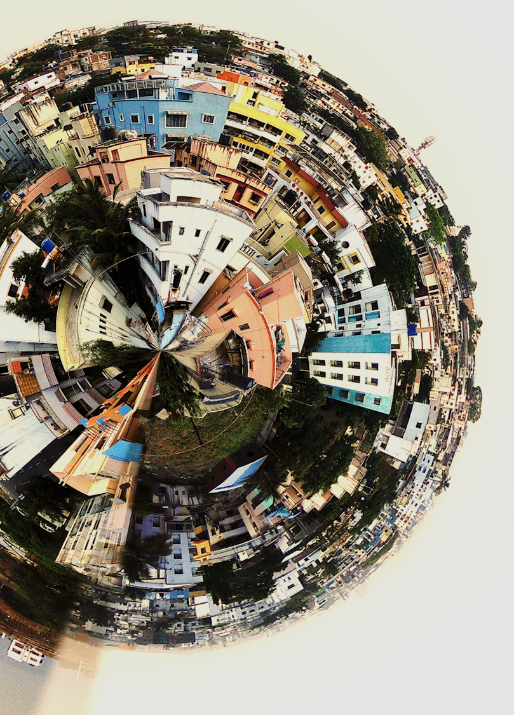
Utility Payment Control Solution Architecture

Slide 5
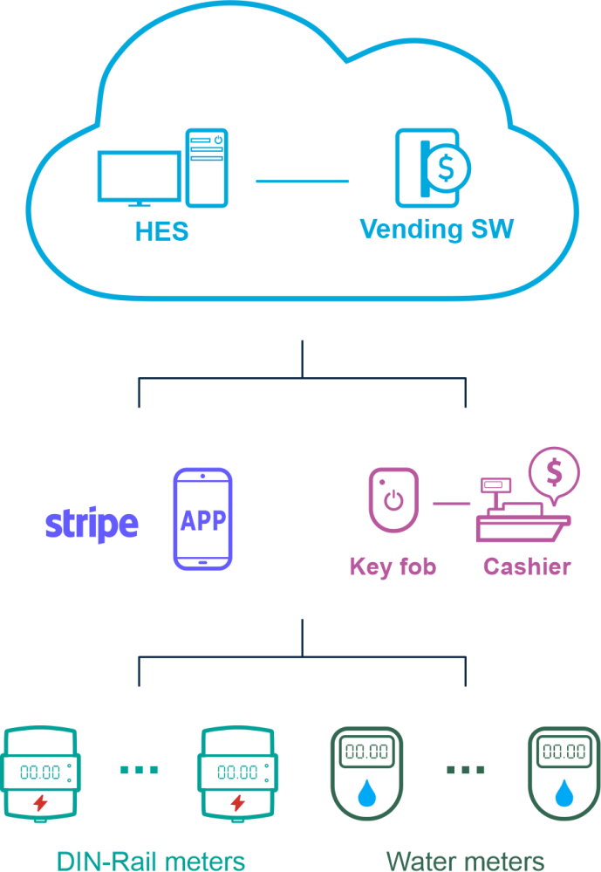
1
ADDERRA Basic configuration
Cloud-based ADDERRA backend
Vending software developed and hosted by ADD GRUP.
Mobile application or smart key fob for electricity and water management
DIN rail mounted Electricity Meter with BLE communication channel (compact, modular types).
Ultrasonic Water meter with BLE communication channel.

Slide 6
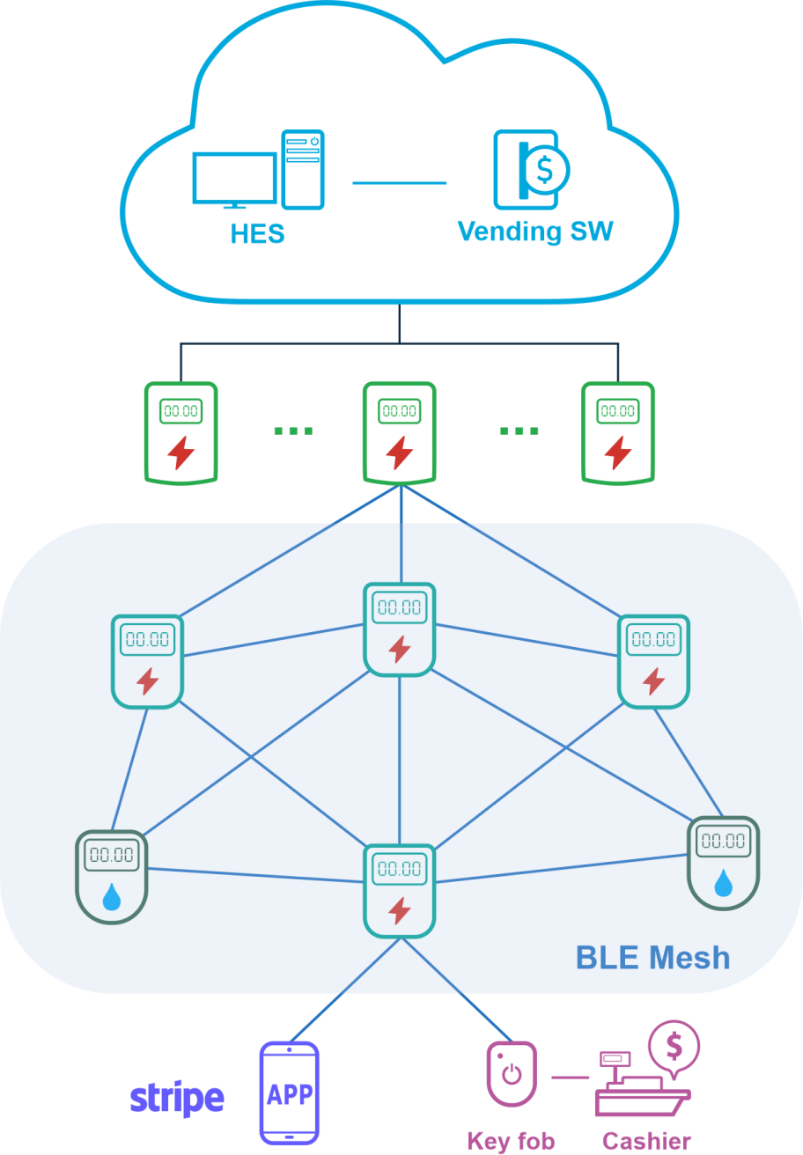
2
ADDERRA Advanced configuration
Cloud based ADDERRA backend
Vending software developed and hosted by ADD GRUP.
Electricity Meter-Gateway with BLE and 3GPP communication channels. Up to 64 devices can be supported.
DIN rail mounted Electricity Meter with BLE communication channel (compact, modular types).
Ultrasonic Water meter with BLE communication channel.
BLE Mesh network structure
Mobile application or smart key fob for electricity and water management

Slide 7
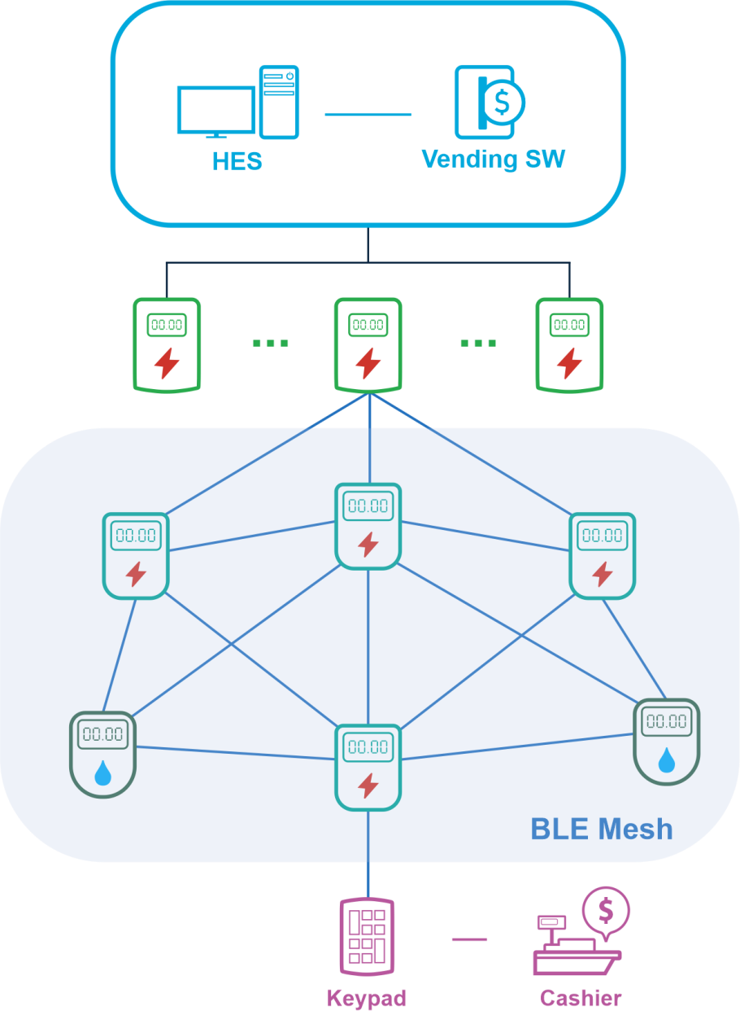
3
Standard AMI Configuration
ADD GRUP or 3rd party HES.
3rd party Vending software.
Electricity Meter-Gateway with BLE and 3GPP communication channels. Up to 64 devices can be supported.
BLE Mesh network structure
DIN rail mounted Electricity Meter with BLE communication channel (compact, modular, classic types).
Ultrasonic Water meter with BLE communication channel.
Remote BLE keypad to enter prepayment tokens and send the tokens to the meter.
Based on STS or other prepayment platform.

Slide 8
Comparative matrix

Slide 9
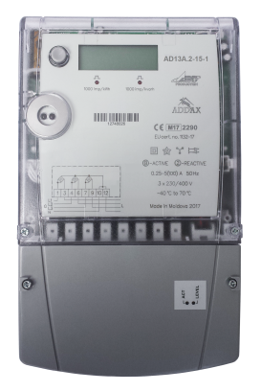
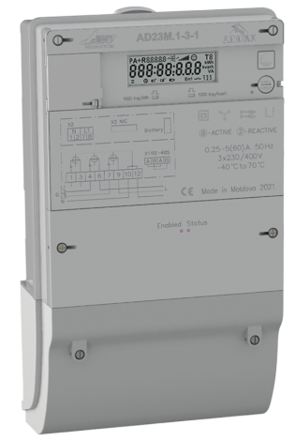
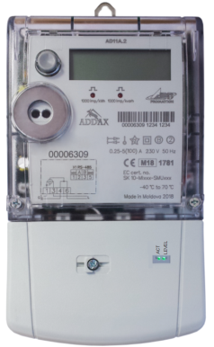
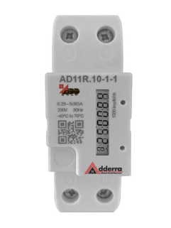
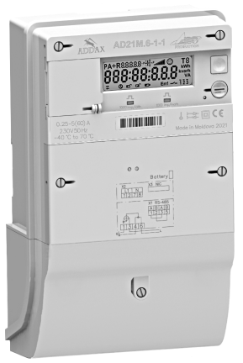
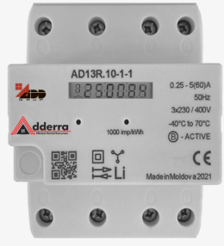
Devices design
Classic meter design
Compact DIN meters
Modular meters with/without communication modules
PLC and BLE communication
DIN rail mounting
Various design to meet local requirements

Slide 10
Communications
BLE serves as many-to-many communications for a group of closely-spaced meters.
100% coverage is not guaranteed.
BLE meters ensures performing the following functions :
Check-in/check-out
Monthly data (once per month – for balance billing)
Services on/off
Easy configuring using special mobile application.
FW update.
Time synchronization.
A command can be sent to all the meters or to a group of meters according to preliminary configured meter list.
It is recommended to place the meter-gateway and the first (nearest) meter within the same metering room (not far than 10-15 m from each other).

Slide 11
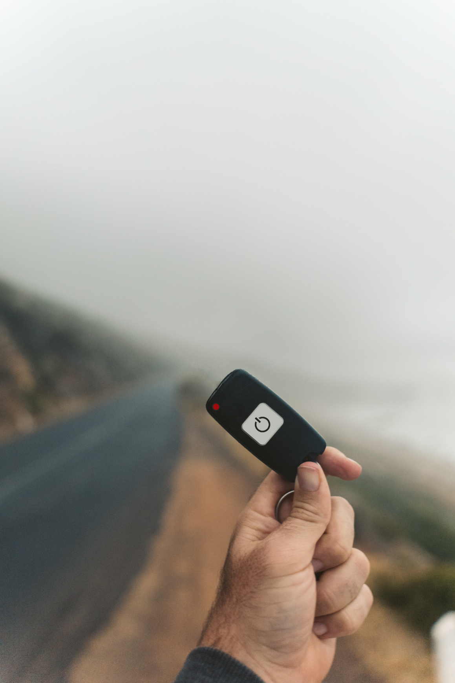
Key fob
The key fob is managed by an administrator (on reception) who accepts payment from the Client and gives possibility to activate resources.
Smart key fob for remote management and resources activation:
Check-in/check-out (Start/stop service) by push button.
Status LED.
Keyboard to enter tokens.
Easy to use and replenish the meter credit.
With each credit replenishment the data from the meter is transmitted to the Landlord (alarms, events, billing data). This option is not available for ADDERRA Basic configuration.

Slide 12
www.addgrup.com

